Slide 1

Transferable, tokenized, value-protected, interest bearing P2P credit

Slide 2
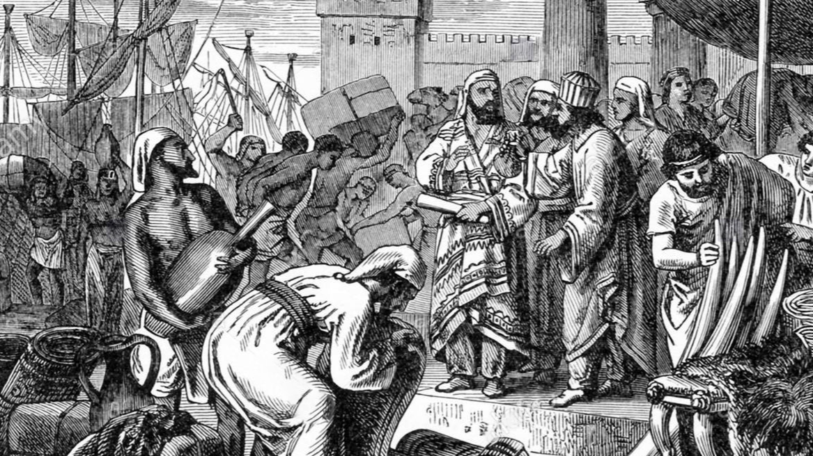
For 5000 years, societies have been.
built on credit.
Today, over 85%.
of global spend.
is on credit.
Notes:
Credit has taken many forms over the ages. This is thought to be the oldest surviving payslip from Uruk, Mesopotamia in modern day Iraq. The workers were paid in credits of beer. Societies have also used other forms such as tally sticks, paper and plastic to issue credit.
According to the latest numbers by the Institute of International Finance, over 85% of global spend is issued via credit.

Slide 3

But where is tokenized, transferable P2P credit.
in the crypto sphere?.

Slide 4
Problem – No transferability of credit
Borrower 1
Lender 1
3rd Party
Borrower 2
Lender 2
4th Party
Notes:
SmartCredit.io is a two tier system. The first part is the lending marketplace.
The real game changer here is monetizable debt - programmable elastic credit money.
All others limit the lending transaction between two parties—the lender and the buyer.
Our system creates a credit certificate called SmartMoney on the blockchain that is transferable immediately.
So lenders can use that SmartMoney to pay other 3rd parties.

Slide 5






Solution – Transferable Tokenized Credit
This is what all other lenders offer......
SmartCredit.io Marketplace + Transferable Tokenized Credit Coins.
Notes:
SmartCredit.io is a two tier system. The first part is the lending marketplace.
The real game changer here is monetizable debt - programmable elastic credit money.
All others limit the lending transaction between two parties—the lender and the buyer.
Our system creates a credit certificate called SmartMoney on the blockchain that is transferable immediately.
So lenders can use that SmartMoney to pay other 3rd parties.

Slide 6



Solution – Interest-Bearing Credit Coins
Loans are tokenized into interest-bearing Credit Coins
Credit protection is implemented via loss provisions and collateral
Lenders / Holders can transfer their Credit Coins to pay third parties

Slide 7


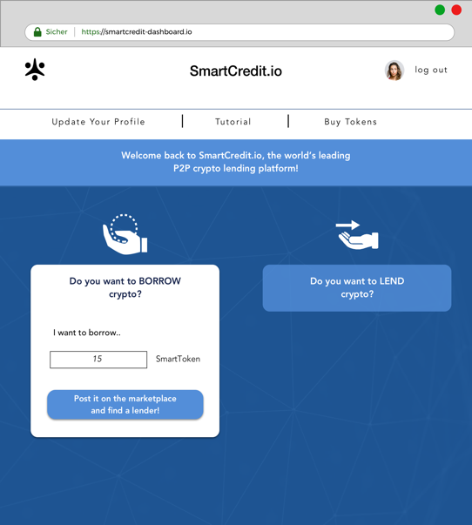

Solution – 3 Steps Ecosystem
Credit Tokenization +
Credit Transferability
2-Click Consumer Credit
Private fixed income funds for Investors

Slide 8
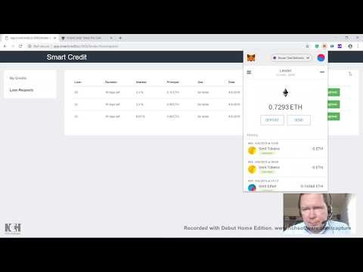
DEMO

Slide 9









Differentiation – 4 times NO by Competition …
Company | P2P | Collateral Needed | Loan Time | Credit Protection | Credit Tokenization | Credit Transferability
 | - | 200-500% | Minutes | Partial | No | No
 | - | 140% | Minutes | No | No | No
 | + | 150% | Hours | Optional | No | No
 | - | 140% | Minutes | N/A | No | N/A
* | + | 0 | Minutes to Hours | 20-30% | No | No
 | - | 200% | Days | N/A | No | N/A
 | - | 200% | Minutes | N/A | No | N/A
 | + | Custom | Days | Cosigners | No | No
 | - | 140% | Weeks to Months | N/A | No | N/A
SmartCredit.io | + | Less | Minutes | Yes | Yes | Yes
Notes:
SmartCredit.io is a two tier system. The first part is the lending marketplace.
The real game changer here is monetizable debt - programmable elastic credit money.
All others limit the lending transaction between two parties—the lender and the buyer.
Our system creates a credit certificate called SmartMoney on the blockchain that is transferable immediately.
So lenders can use that SmartMoney to pay other 3rd parties.

Slide 10
Business Model
We take 0.5% fee from every lending transaction

Slide 11
Market
5 Million
Potential Millenial
Clients NOW in Europe and North America

Slide 12








Global Roadmap
Pilot
Minimum Viable Product
Marketplace Launch Europe
￥
US Expansion
DEC 17
MAY 18
DEC 18
FEB 19
APR 19
Summer
+6 MOS
+12 MOS
White Paper published
Registration open
Licences
East Asia Expansion

Slide 13

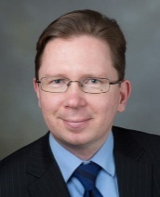

We are the team building the credit system for the crypto world.
Martin Ploom, CEO
Former VP of Credit Suisse, built 3 AI-based products,3 masters degrees + EMBA + CFA III
Tarmo Ploom, CTO
Credit Suisse, Distinguished IT Architect (OpenGroup), 3 masters degrees + Ph.D. + MBA + CFA + CAIA
Daniel Burgwinkel, Ph.D.
Former dept head for Credit Suisse, wrote thesis on digital contracts & law before bitcoin whitepaper.
Walter Dettling, Ph.D.
Professor of financial mathematics & blockchain at the University of Applied Sciences in Basel.
Asse Sauga
Founding director of Bitcoin Foundation Estonia
John Matonis
Founding director of the Bitcoin Foundation.
Norbert Perrot
Head of Credit Risk for the biggest consumer lending bank in Switzerland.
Bodo Näf, Ph. D.
15 years in Credit Suisse private banking
50+ years building enterprise apps.
50+ years in banking.
30+ years in blockchain.
20+ years in credit lending.
5 employees.
4 PhDs.
2 CFAs.
Notes:
We are the team building credit into the crypto market. We have a dream team of deeply experienced financial experts. At least 6 are formerly from Credit Suisse. We have a few from Goldman Sachs, UBS, JP Morgan, Bank of America, Merrill Lynch and Deutsche Bank. The team is diversified as well, with experts in capital markets, derivatives, credit markets, credit risk and of course, technology.
We are experienced in blockchain as well. Myself and my co-founder twin, started our work in blockchain in 2012. We have one advisor who wrote thesis about digital contracts years before Satoshi published his paper. One has written a book on blockchain. We also have the founding director of the Bitcoin Foundation, Jon Matonis himself. We have been immersed in this space for significant time.
All this business and blockchain experience means nothing if we don’t have technologists. We have that too, probably the most significant depth in our bench lies in building enterprise applications with over 100 years of experience.
Our team has been working together for a year to prove our thesis, develop a pilot and craft a business plan.

Slide 14



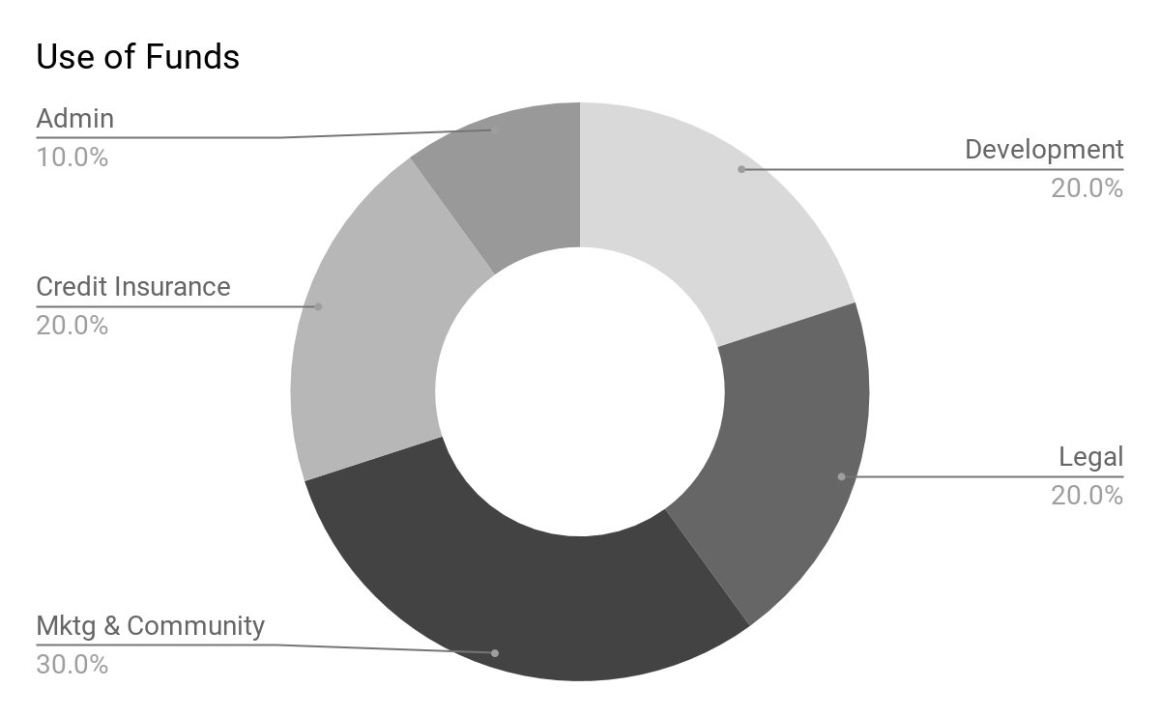
Capital Raise.
Convertible Note
and
Pre-sale Tokens for
$500,000
Seed Round
$500,000
Previous Funding
$125,000
Committed capital from founders, with $30K remaining.
IEO Hard Cap
$25M ETH
After 10K members verified on whitelist

Slide 15

It’s Evolution!.
Bitcoin defined the base money for the internet.
SmartCredit.io enables.
Transferable Interest Bearing Credit Money.
for the internet.

